Slide 1
Ancient Egypt
Vocabulary Slideshow

Slide 2
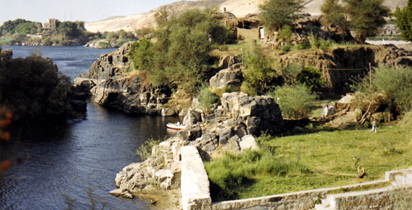
cataracts
rapids along a river

Slide 3
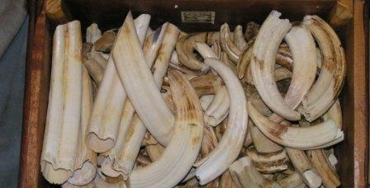
ivory
white material made from tusks of elephants

Slide 4
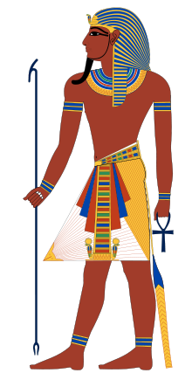
pharaoh
name for a powerful ruler

Slide 5
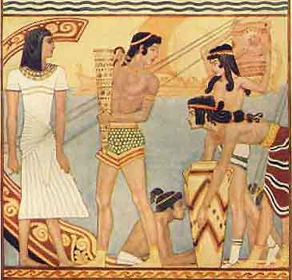
trade network
system of people in different lands who swap goods back and forth

Slide 6
ebony
hard, durable black wood

Slide 7
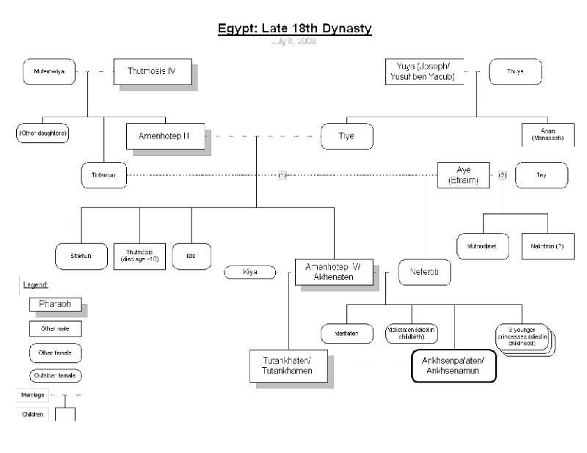
dynasty
line of rulers from a single family that holds power for a long time

Slide 8
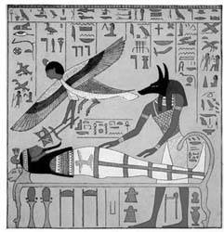
afterlife
life after death

Slide 9
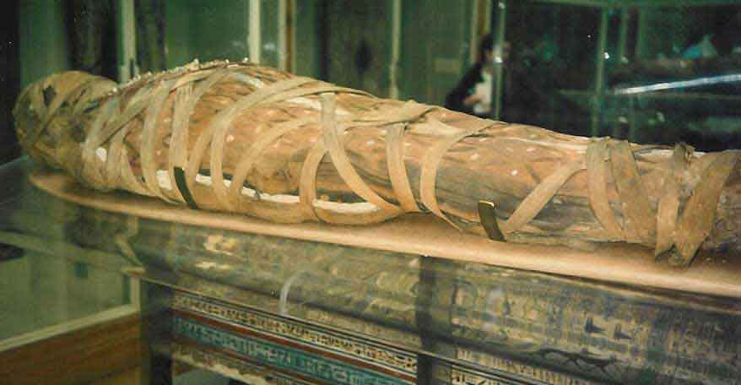
mummy
specially treated body wrapped in cloth for preservation

Slide 10
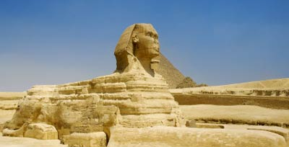
sphinx
figure of an imaginary creature with the head of a man and the body of a lion

Slide 11
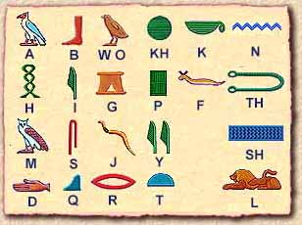
hieroglyphics
system of writing that uses small pictures to represent sounds or words

Slide 12
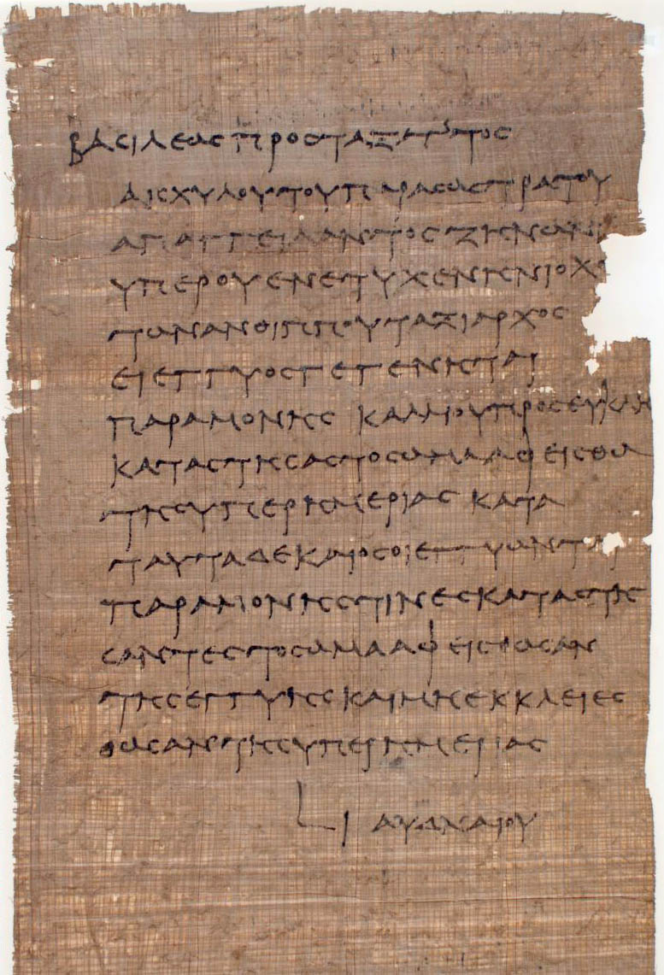
papyrus
long-lasting, paper-like material made from reeds; used to write on

