Slide 1
Empires in the Middle East

Slide 2
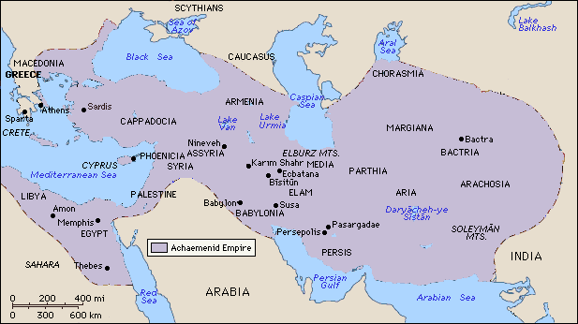
The Persian Empire

Slide 3
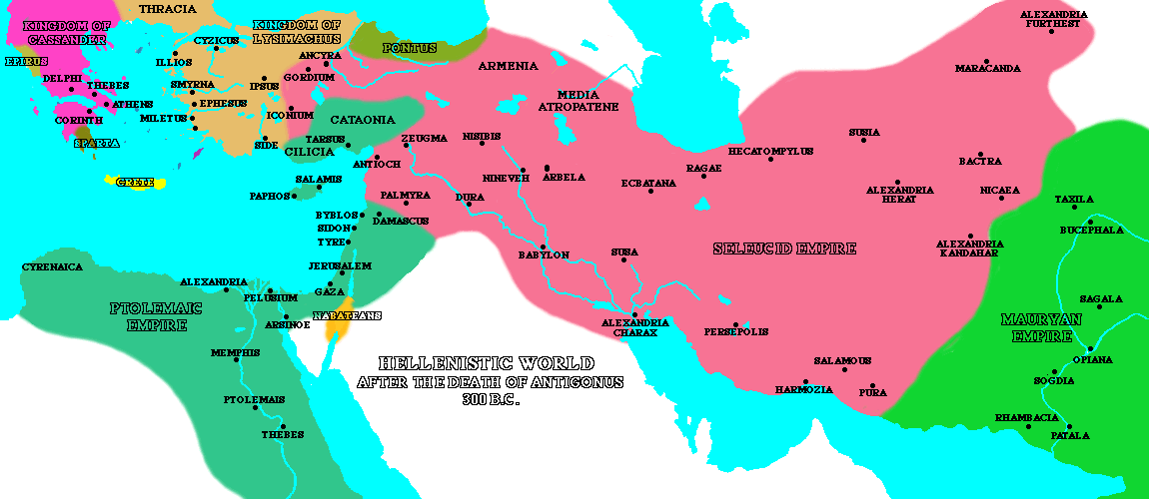
The Hellenistic Empire

Slide 4
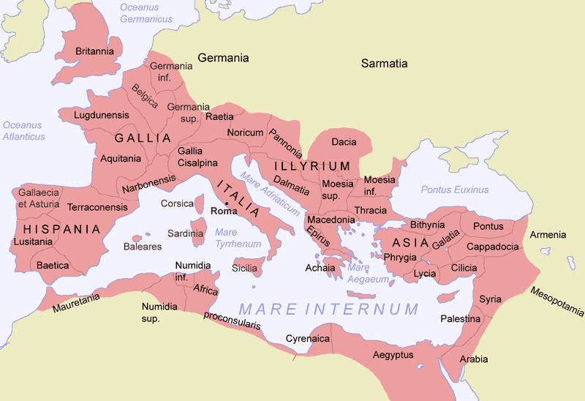
The Roman Empire

Slide 5
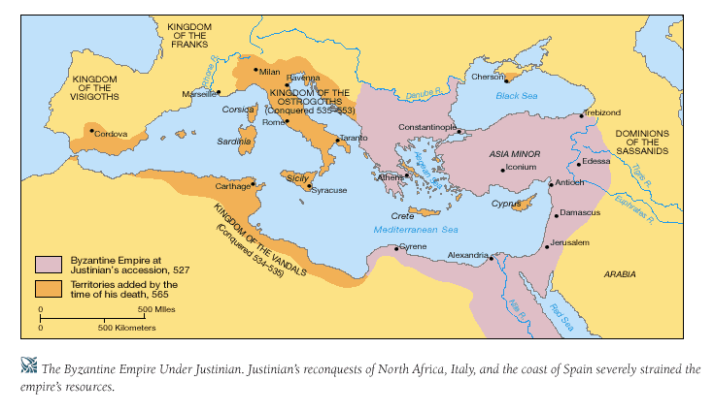
The Byzantine Empire

Slide 6
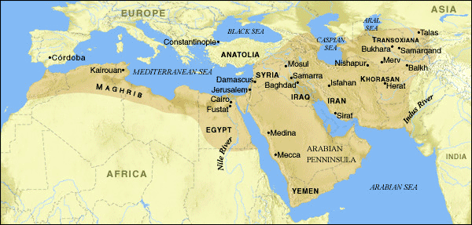
The Abbasid Empire

Slide 7
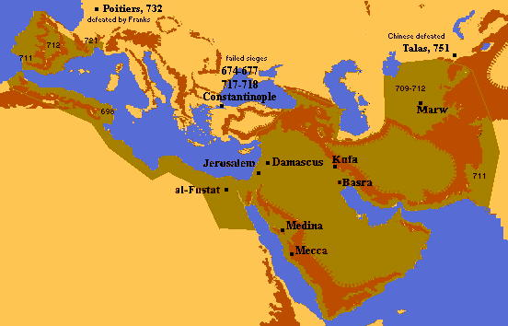
The Umayyad Empire

Slide 8
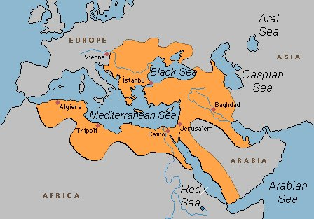
The Ottoman Empire

