Slide 1
Types of Government
Democracy
Oligarchy
Dictatorship
Monarchy
Anarchy
Rule by Many
Rule by a Few
Rule by One
Rule by None

Slide 2
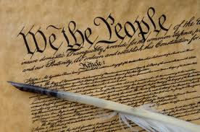
Two Types of Democracy
All citizens participate
No representatives –citizens vote on issues
Example – Ancient
Athens
All citizens participate
People elect representatives who vote on the issues
Representatives answer to the people and usually must follow a constitution
Example - USA
DIRECT
REPRESENTATIVE
Democracy is any type of government where power is held by all citizens.

Slide 3
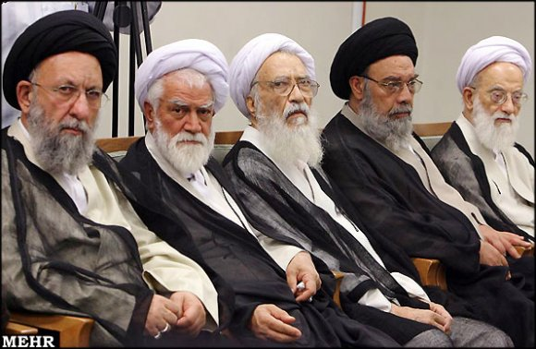
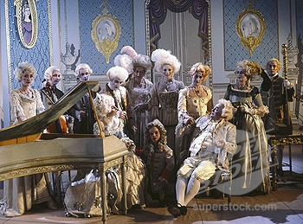
Oligarchy
An oligarchy is any society ruled by a small group of people. There are several different types of oligarchies, but the two most common are:
rule by a small group
of wealthy and well
educated citizens
power is usually passed
down within certain
families
Example – Medieval
Europe
Aristocracy
rule by a group of
religious leaders
religious law is used to
govern
Example – the Islamic
Republic of Iran
Theocracy

Slide 4
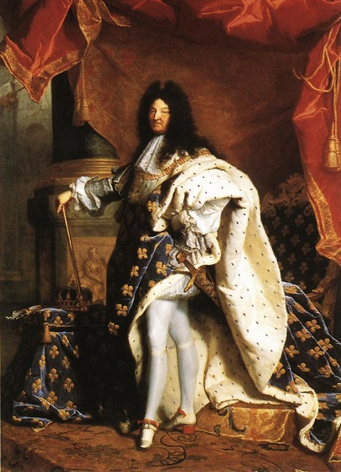
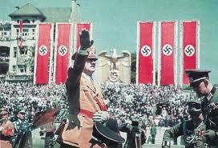
Autocracy
An autocracy is any society ruled by a one person.
The two most common forms of autocracy are:
power is taken by force
dictators have total
control over the lives
of the people
people have few rights
Example – Nazi Germany
Dictatorship
rule by kings, queens
and other types of
royalty
power is passed down,
usually from father to
son
Example – France in the
1600s and 1700s
Monarchy

Slide 5
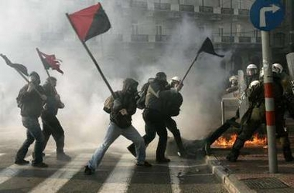
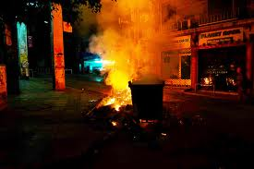
Anarchy
Anarchy is the absence of government.
There is no government to make or enforce laws.

